Slide 1

General Manager Presentation
Kent Rodgers
January 15, 2021

Slide 2

Building Something Special!
“We’re on a mission to reinvent shipping.”
This Photo by Unknown Author is licensed under CC BY

Slide 3
Key Building Blocks
Purpose
Mission
Clients
Value
Relationships
Team
Process
Technology
Tools
Design an organization that will profitably achieve industry leading on-time delivery and client rating performance.
What would the team look like?
What is the background of each supervisor, and where will you recruit them from?
What is the reporting structure?
What roles operate across the whole region vs. only for the local market?
What are the KPIs you would use?
What meetings would your teams have and at what cadence?
What unique management insights would you bring to your team that would make them a model for how a market/region within the Veho organization should operate?
Values
Behaviors
Alignment
Leadership
Culture
Development
Engagement
Focus
Organizational Structure
Team Roster
Talent
This Photo by Unknown Author is licensed under CC BY

Slide 4
Pre-Wire the Org. Structure for Growth
Organize our team’s for success in four key process areas in a rapidly changing environment
Region
Recruit & Train
Fractional
X-Small
Lead
Small
Supervisor
Medium
Manager.
Up to 7
Stations
Driver Success
Supervisor
<10 hour station window
---
<12 ground operations associates
<20 hour station window
---
< 24 ground operations associates
---
<= 2 leads
<20 hour station window
---
< 100 ground operations associates
---
<= 5 supr./leads
In-Route coordination
+ coaching
---
Approximately 1 associate for every 200 daily route hours
Receive
Sort
Launch
Deliver
Deliver
2021 Copyright Kent Matthew Rodgers

Slide 5
Be Clear on How We Create Value
Establish focus and alignment with
5 to 7 role specific performance metrics
2021 Copyright Kent Matthew Rodgers

Slide 6
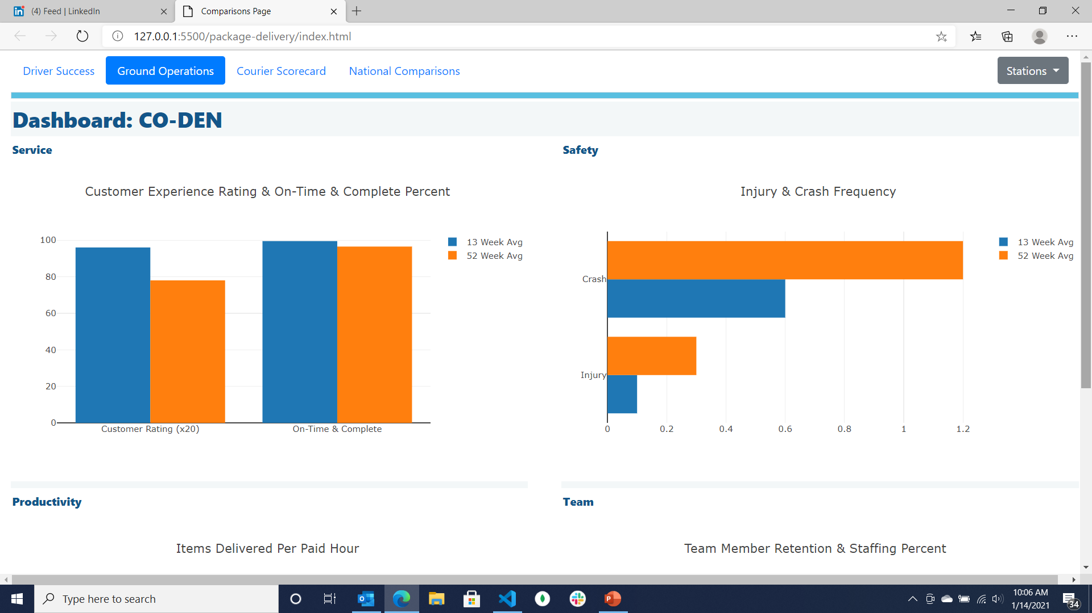
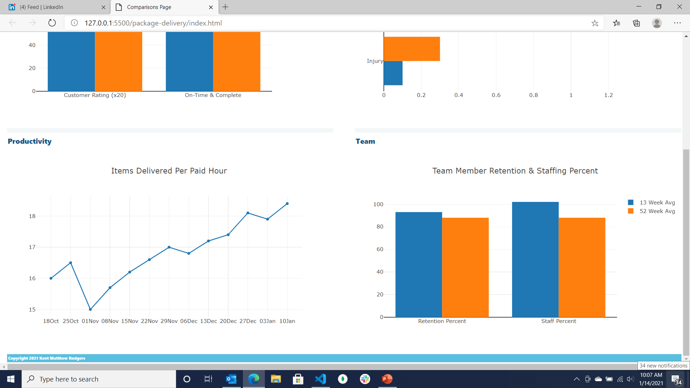
Achieve w/Performance Awareness & Candor
Create situational awareness through dashboards+
2021 Copyright Kent Matthew Rodgers

Slide 7














Build Culture, Team & Engagement
Build all-things culture with a comprehensive communication & engagement program
Frontline
Team
One-One
Leader
2021 Copyright Kent Matthew Rodgers

Slide 8
Talent Acquisition – Team Roster
Where to find leaders …
From the current team
From the team’s network
Passive and targeted outside search
Collegiate development track / program
… Full-time recruiter at 60+/- active hourly hires. Fractional as starter or flex
Recruiting process will be key as the team clearly knows
2021 Copyright Kent Matthew Rodgers

Slide 9
Building Team Roster
Hire for both experience and demonstrated competency
---
Supervisor Background
Must have:
2 years driver, warehouse, transportation or field services experience
2 years overseeing performance of others as hourly leader or salary supervisor
Note: Profile built using the Korn Ferry Leadership Architect tool
2021 Copyright Kent Matthew Rodgers

Slide 10
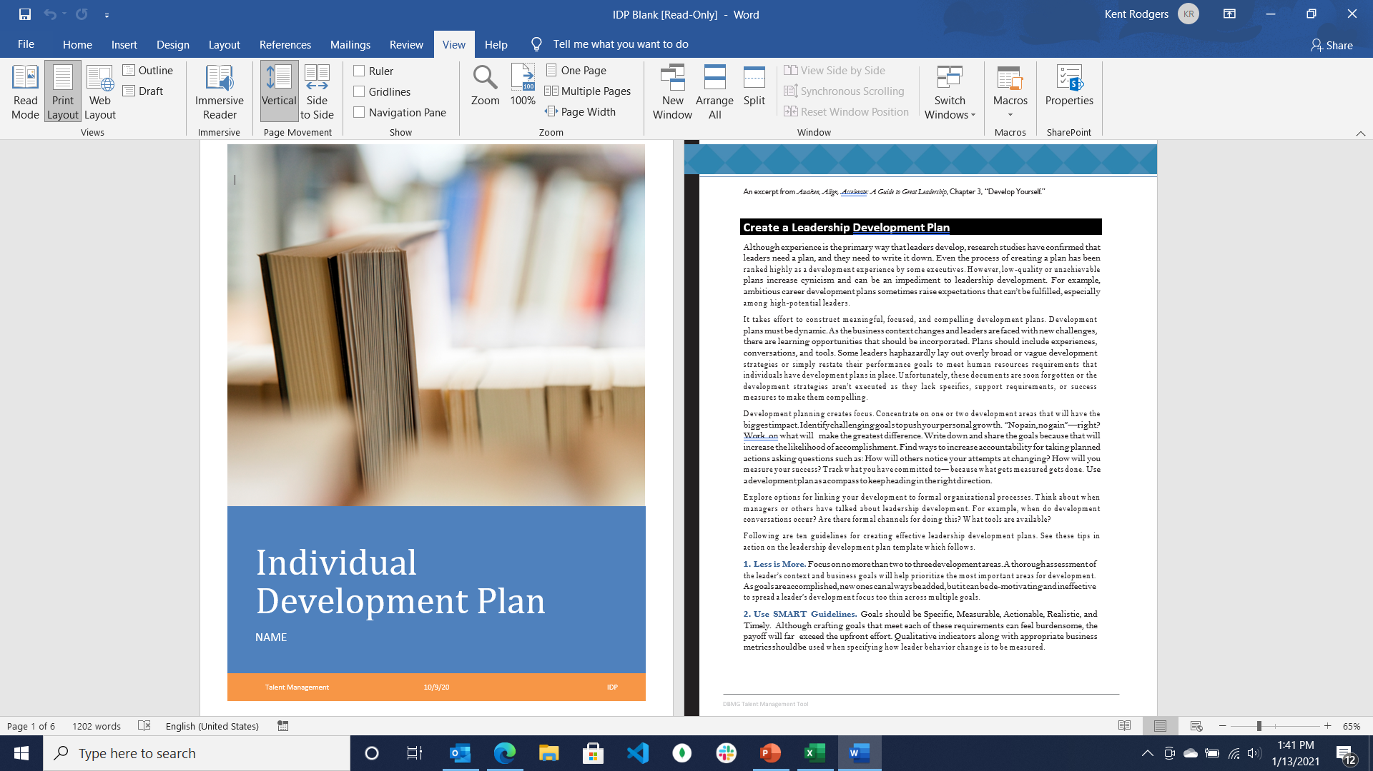
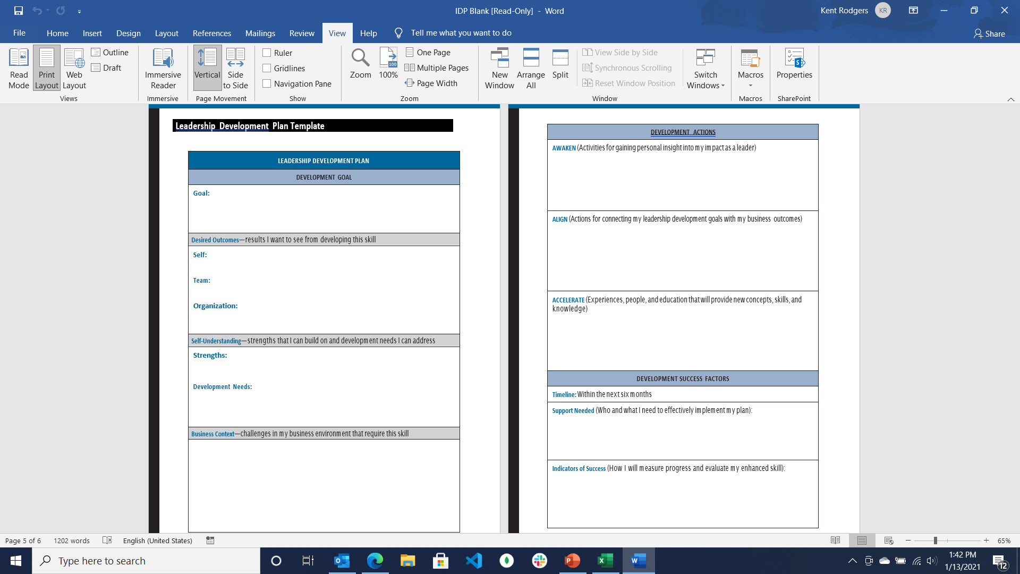
Talent Development
Individual development plan
Targeted training (examples below)
Team
Future success will be decided upon today’s investment
---
Let’s invest in Training & Development
Change Leadership
Communication
2021 Copyright Kent Matthew Rodgers

Slide 11
Unique Insights to Compliment Team …
Three time growth champion in field service, station management and route logistics
… anesthesia, physical and digital information, cash
Know how to build and keep frontline, driver and client relationships
Focus on the right things … with data driven strategy and actions
Build leaders with stewardship in addition to development plans, training & coaching
‘Team’ is founded on trust, responsible candor (conflict), commitment, accountability & results(1)
Note: 1) Reference The Five Dysfunctions of a Team, Patrick Lencioni to provide proper credit here.
2021 Copyright Kent Matthew Rodgers

